Slide 1
Wine Alcohol Level Prediction
Yagiz Sezersan

Slide 2
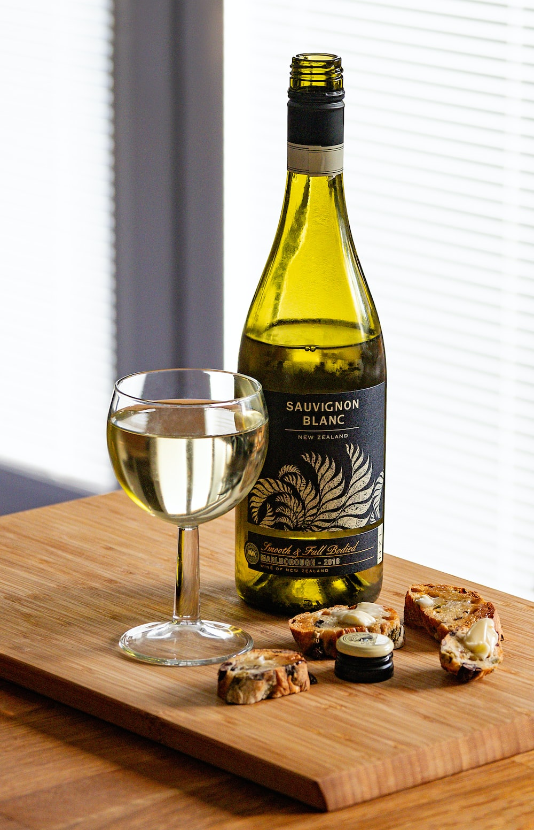
Objective
Predict alcohol level content from white wines given relevant data regarding the wine qualities and compositions.
Notes:
Why is this important? Alcohol content in wines have a lot to do with the texture and flavour of the wine. Depending on the alcohol content of wine, a subtle impression of sweetness is imparted on the palate.
The alcohol content of wine also has an enormous impact on wine’s texture. We tend to think that wine is something that we smell and taste, but there is also an important tactile component to wine tasting.

Slide 3
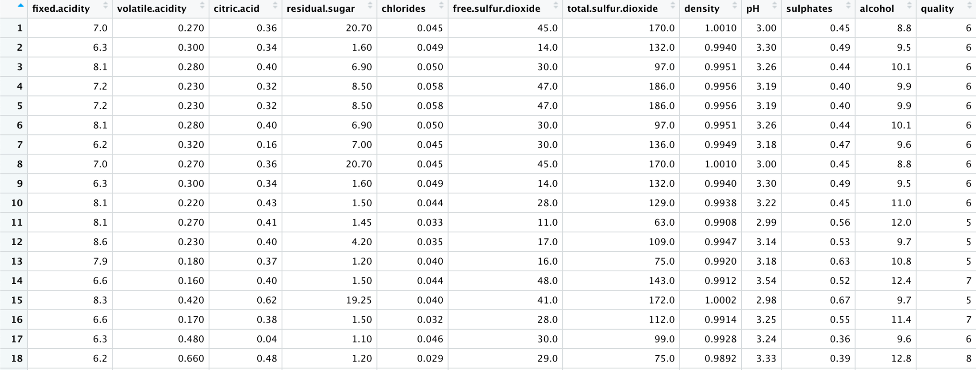
We get the data set from the UCI Machine Learning Repository and the link to the data set is following:
Data Overview
https://archive.ics.uci.edu/ml/datasets/wine+quality
Wine Quality - UC Irvine Machine Learning Repository
Notes:
All numerical data and all are data concerning attributes that correspond to the composition of a wine.

Slide 4
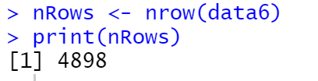
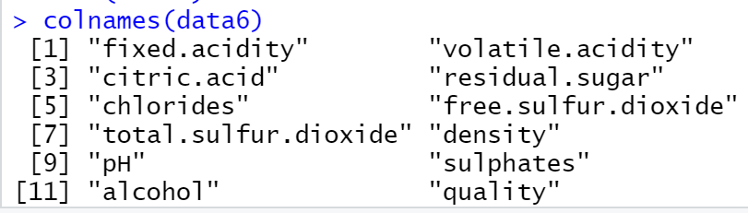
Data Overview
The data set have total 4898 rows and 12 columns as shows in the figure

Slide 5
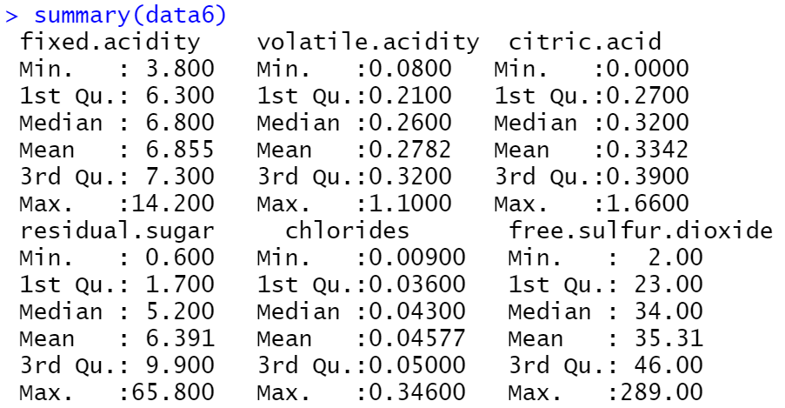
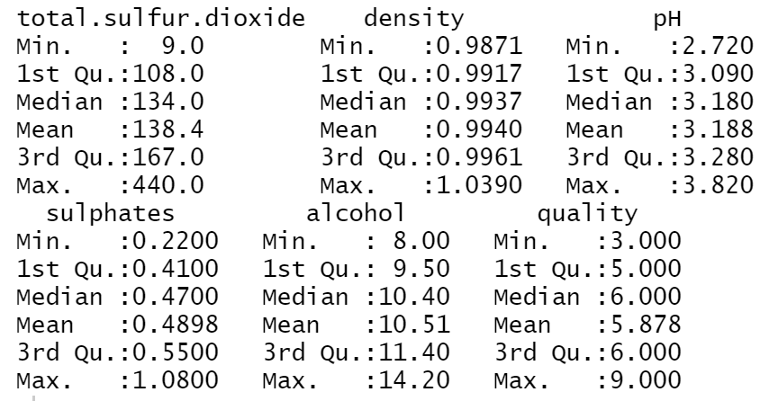
Data Overview
The summary function is a built-in R function used to produce result summaries of various model fitting functions.
Notes:
Alcohol levels range from 8% to 14.9 % in the case of white wines in this dataset
Quality only ranges from 3 to 9 and most data is clustered in the range of 5 to 7 so no accurate prediction will likely come from quality since a lot of the wine will have the same quality score even though they have different attributes.

Slide 6

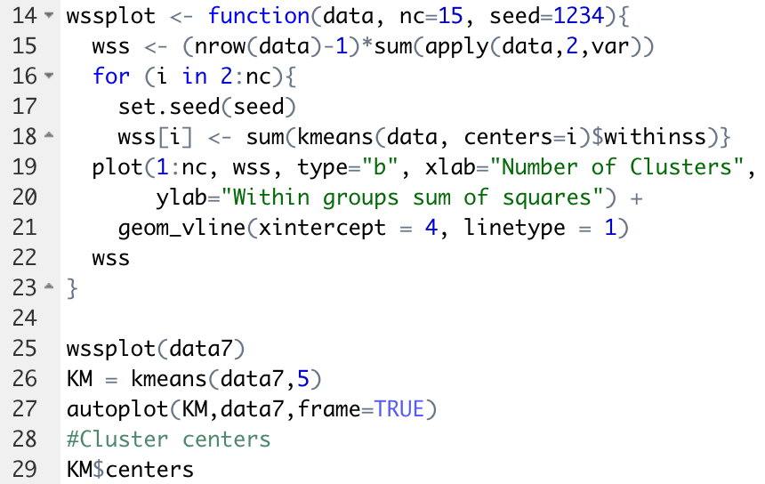

Clustering

Slide 7
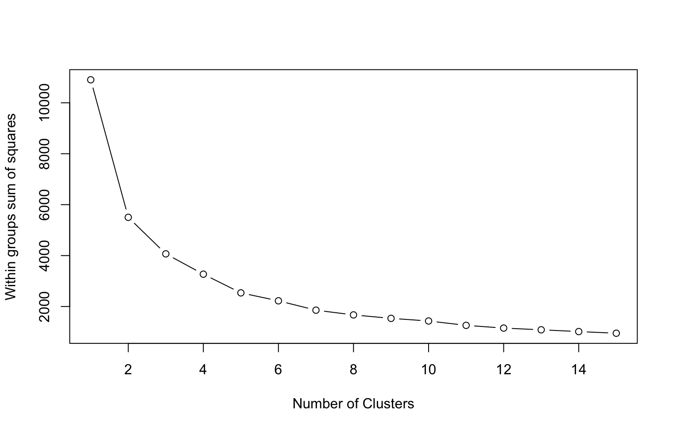
Visualizations Clustering
Notes:
We implemented the elbow method and we chose 5 clusters since the difference in the slope become less starting at 5 clusters.

Slide 8
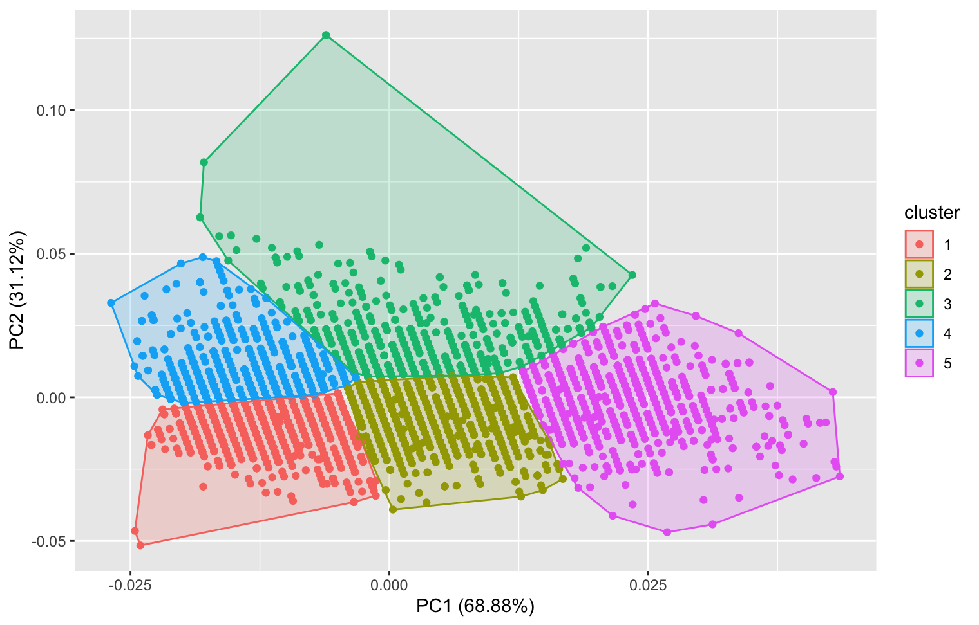
Visualizations Clustering
K means clusters for Alcohol vs. Fixed Acidity
Notes:
This results show fixed acidity vs. alcohol content and show 5 clusters. There is not much variation since most values tend to be within a small range, in this case alcohol from 8% to 14% and fixed acidity from 3% until 14 %

Slide 9

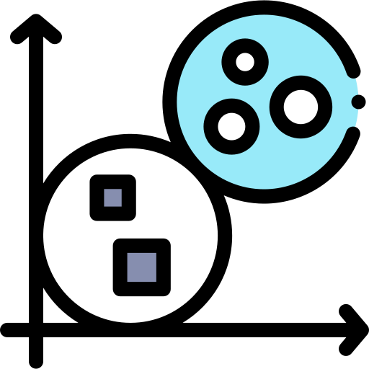


Key insights from Clustering model
Elbow method
Clear clusters
This method shows a clear view of how many clusters there should be.
There are 5 clear clusters in the plot and those refer to various different wines
Balance for alcohol and acidity
Easy of code
Alcohol plays a big part in taste of wine, therefore a balance between alcohol and acidity plays a big part
This method can be applied to other features as well for wine segmentation
Notes:
Talk about how we utilized the elbow method to select the best number of clusters that fitted the data
Clear clusters can be seen in the plot, even though they are not too far apart since there is not much data variation.
How acid or sweet a wine is perceived different by each individual however having a balance for alcohol and acidity like the middle clusters can be a good particular wine. It will all depend on the individuals taste buds
This code can be implemented on any feature in the dataset (results will vary) and can try to find the correct differentiation or segmentation based on the feature for each case.

Slide 10
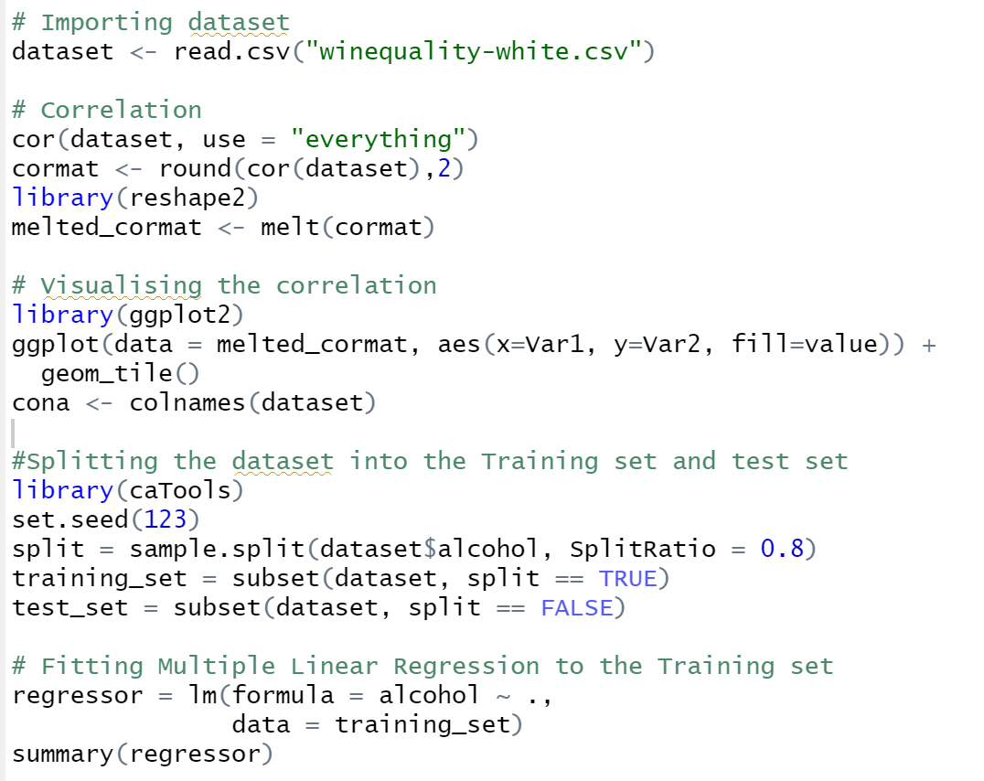
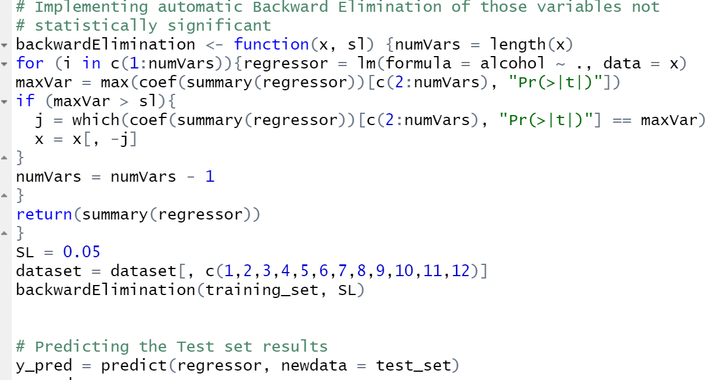
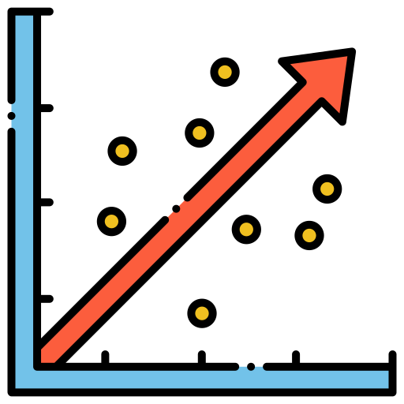
Linear Regression

Slide 11
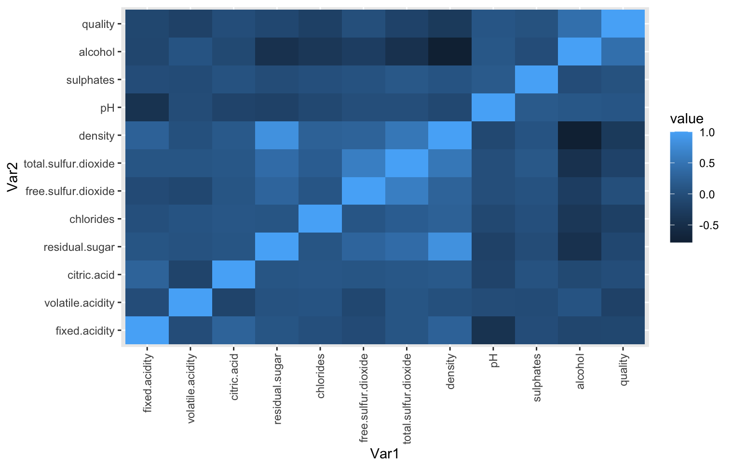
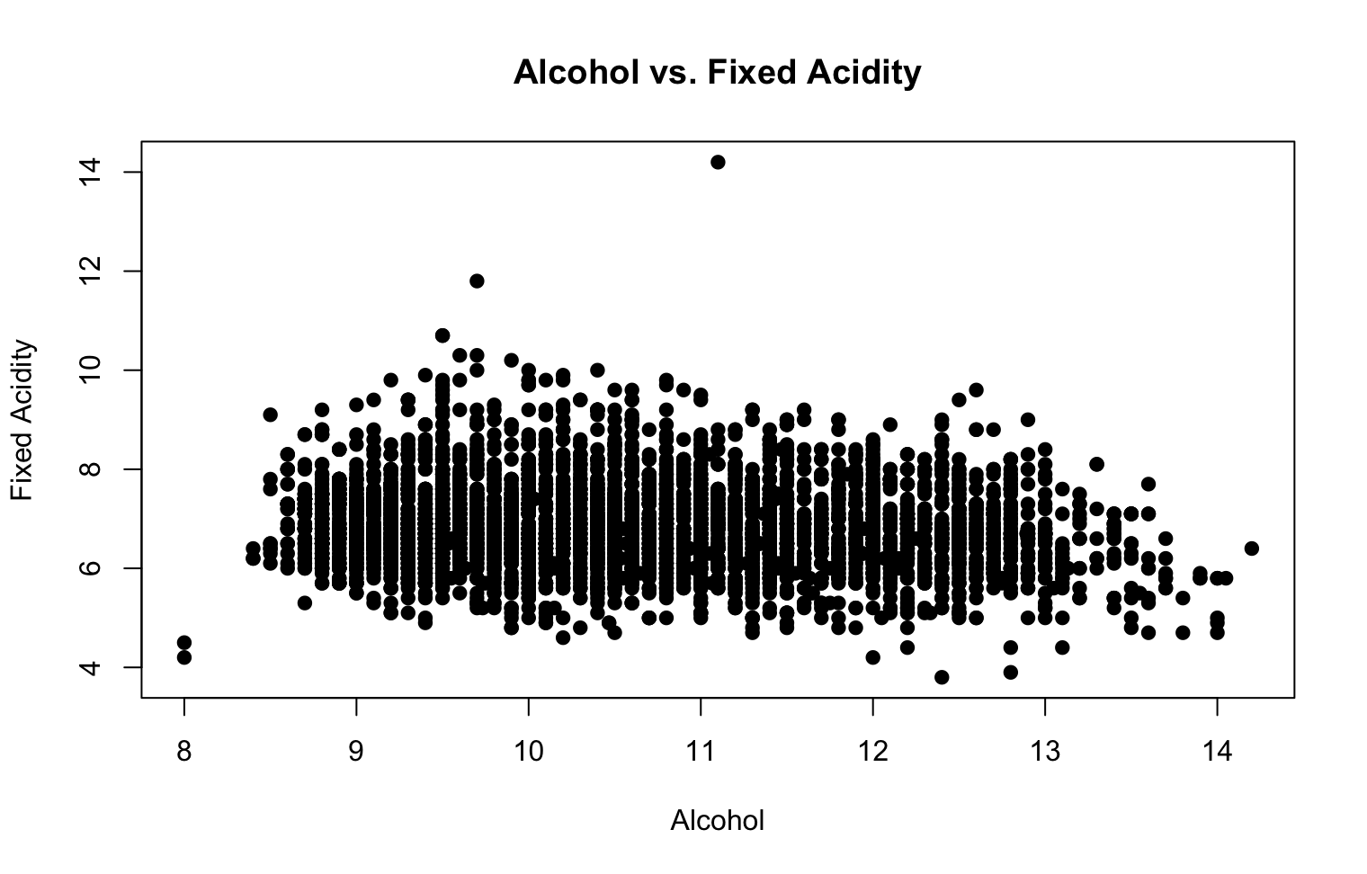
Visualizations Linear Regression
Correlation Heatmap
Notes:
There is a visual representation of the correlations between the features.
Scatter plot shows alcohol vs. Fixed acidity, no clear linear tendency so meaning as the alcohol content increases the fixed acidity not always increases. It will depend very much on the wine and other attributes.

Slide 12
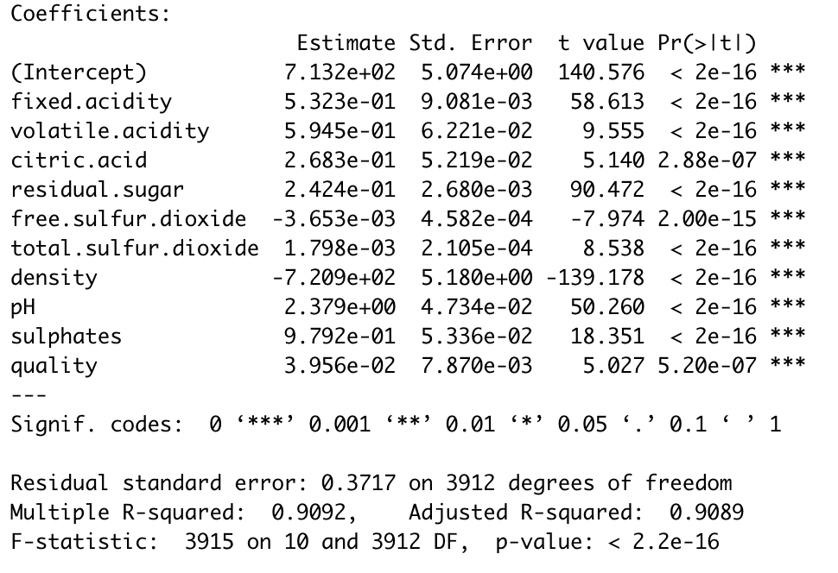
Linear Regression Results
Notes:
Things to note:
High Adjusted R-squared of 0.9089
As hypothesised at the beginning, quality is not very good for the prediction since most wines have the same score even though they have different attributes, that is why the coefficient for this is not big.
Acidity take part in the first 3 coefficients with high coefficients relative to other, this most mean that to determine alcohol content, acidity plays a big part.

Slide 13



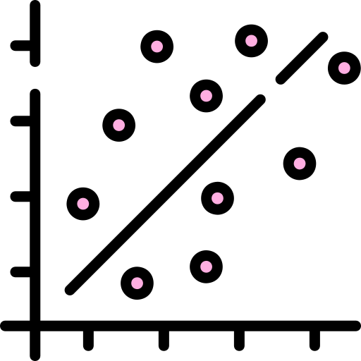
Key insights from linear regression model
High accuracy
Few Features
Model obtained an adjusted R-squared of 0.909
Implemented backward elimination to remove features not statistically significant
Minimum code
Feature correlation
Code can be implemented in quick succession and with all features. (Scores will vary)
Obtained a high R-squared even with many attributes with low correlation

Slide 14
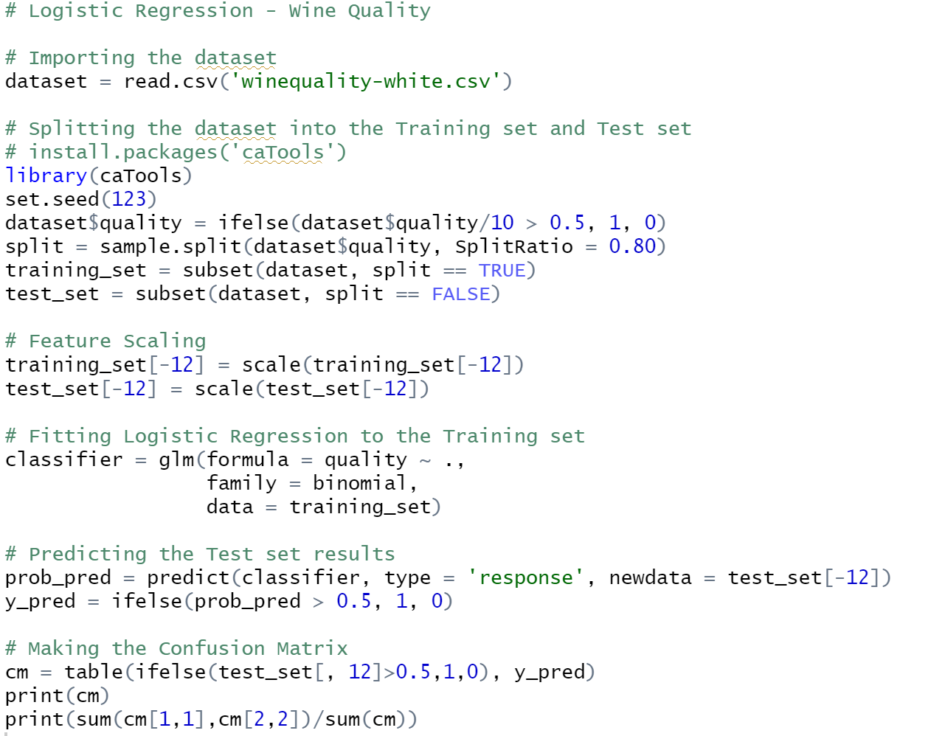
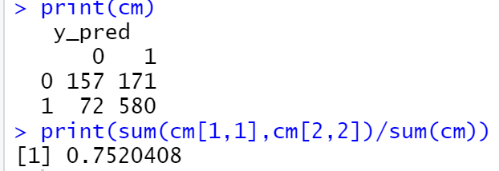
Logistic Regression
We used Logistic regression to predict the quality of white wine based on the chemical attributes of the wine. 0 is not good, 1 is good. we converted the data by using our quality score divided by 10. For those score above 0.5, we identified as good (1), below 0.5 as bad (0) .
Accuracy is 0.752.

Slide 15
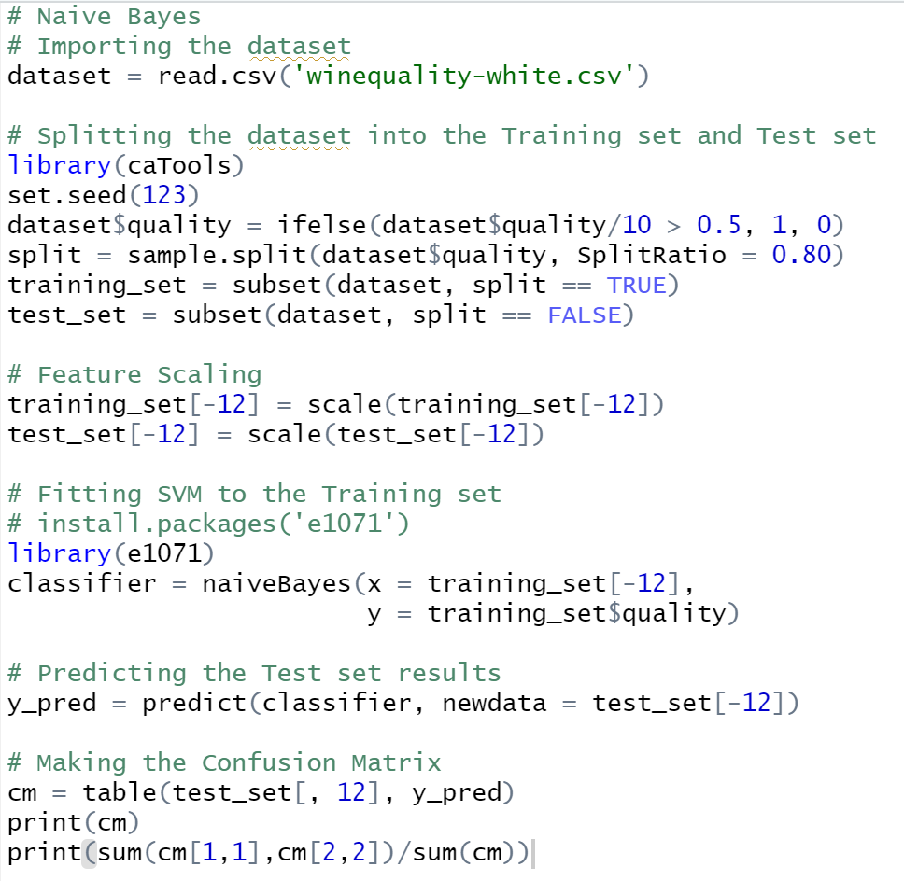
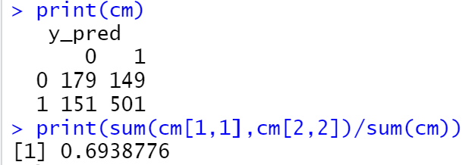
Naive Bayes
We also tried Naive Bayes to predict the quality of white wine based on the chemical attributes of the wine. 0 is not good, 1 is good. we converted the data by using our quality score divided by 10. For those score above 0.5, we identified as good (1), below 0.5 as bad (0) .
Accuracy: 0.6939.

Slide 16
Summary
In this project, we used a white wine dataset to predict alcohol levels based on physical and chemical properties.
At the beginning of the project, we did a review of the data, deduced the main indicators of our data set.
We then applied the clustering method to look for patterns.
Then we tried 3 different models Linear, Logistic, Naive Bayes, the accuracy of the linear model is good, so we chose it as the best model.
For logistic regression, we created training and testing sets that we used to build the model. After we applied the Naive Bayes classifier, these algorithms resulted in a prediction accuracy of about 70 percent, but we were not satisfied with the results.

Slide 17
References
[1] - Cortez,Paulo, Cerdeira,A., Almeida,F., Matos,T. & Reis,J.. (2009). Wine Quality. UCI Machine Learning Repository.

